Slide 1

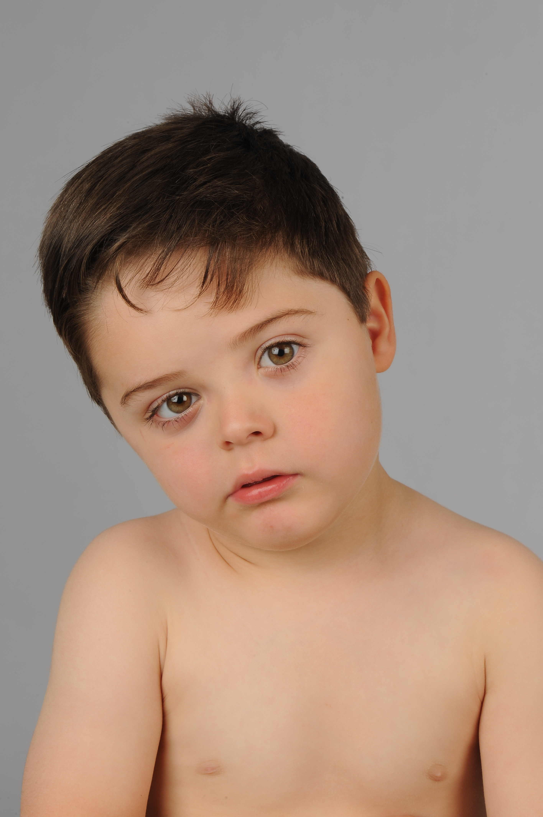
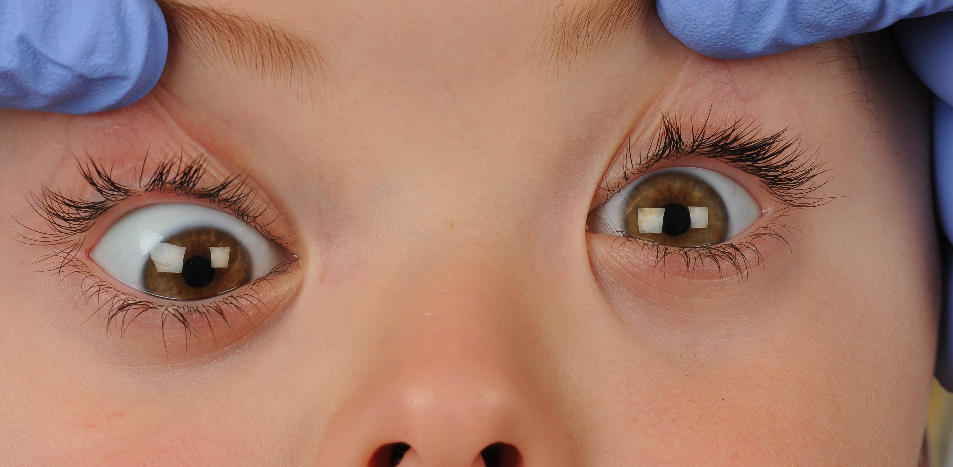
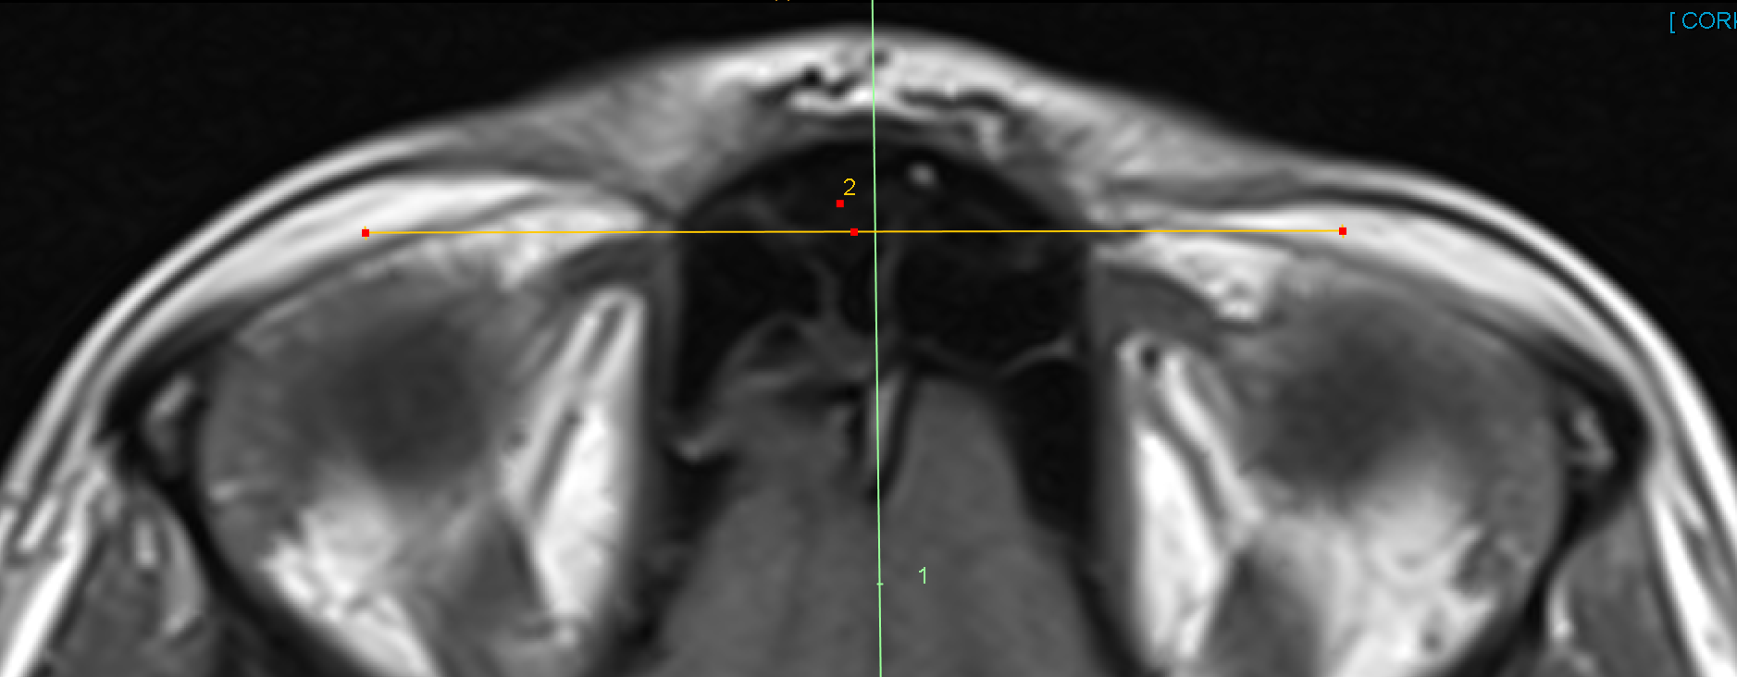
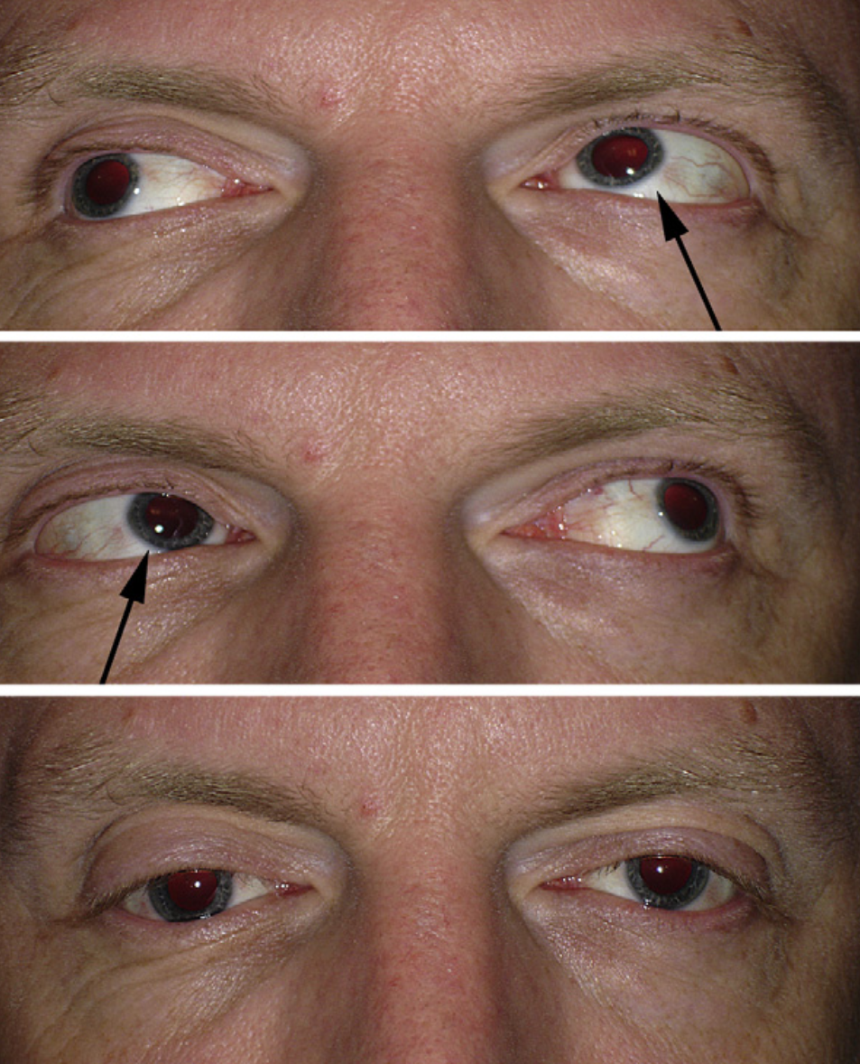
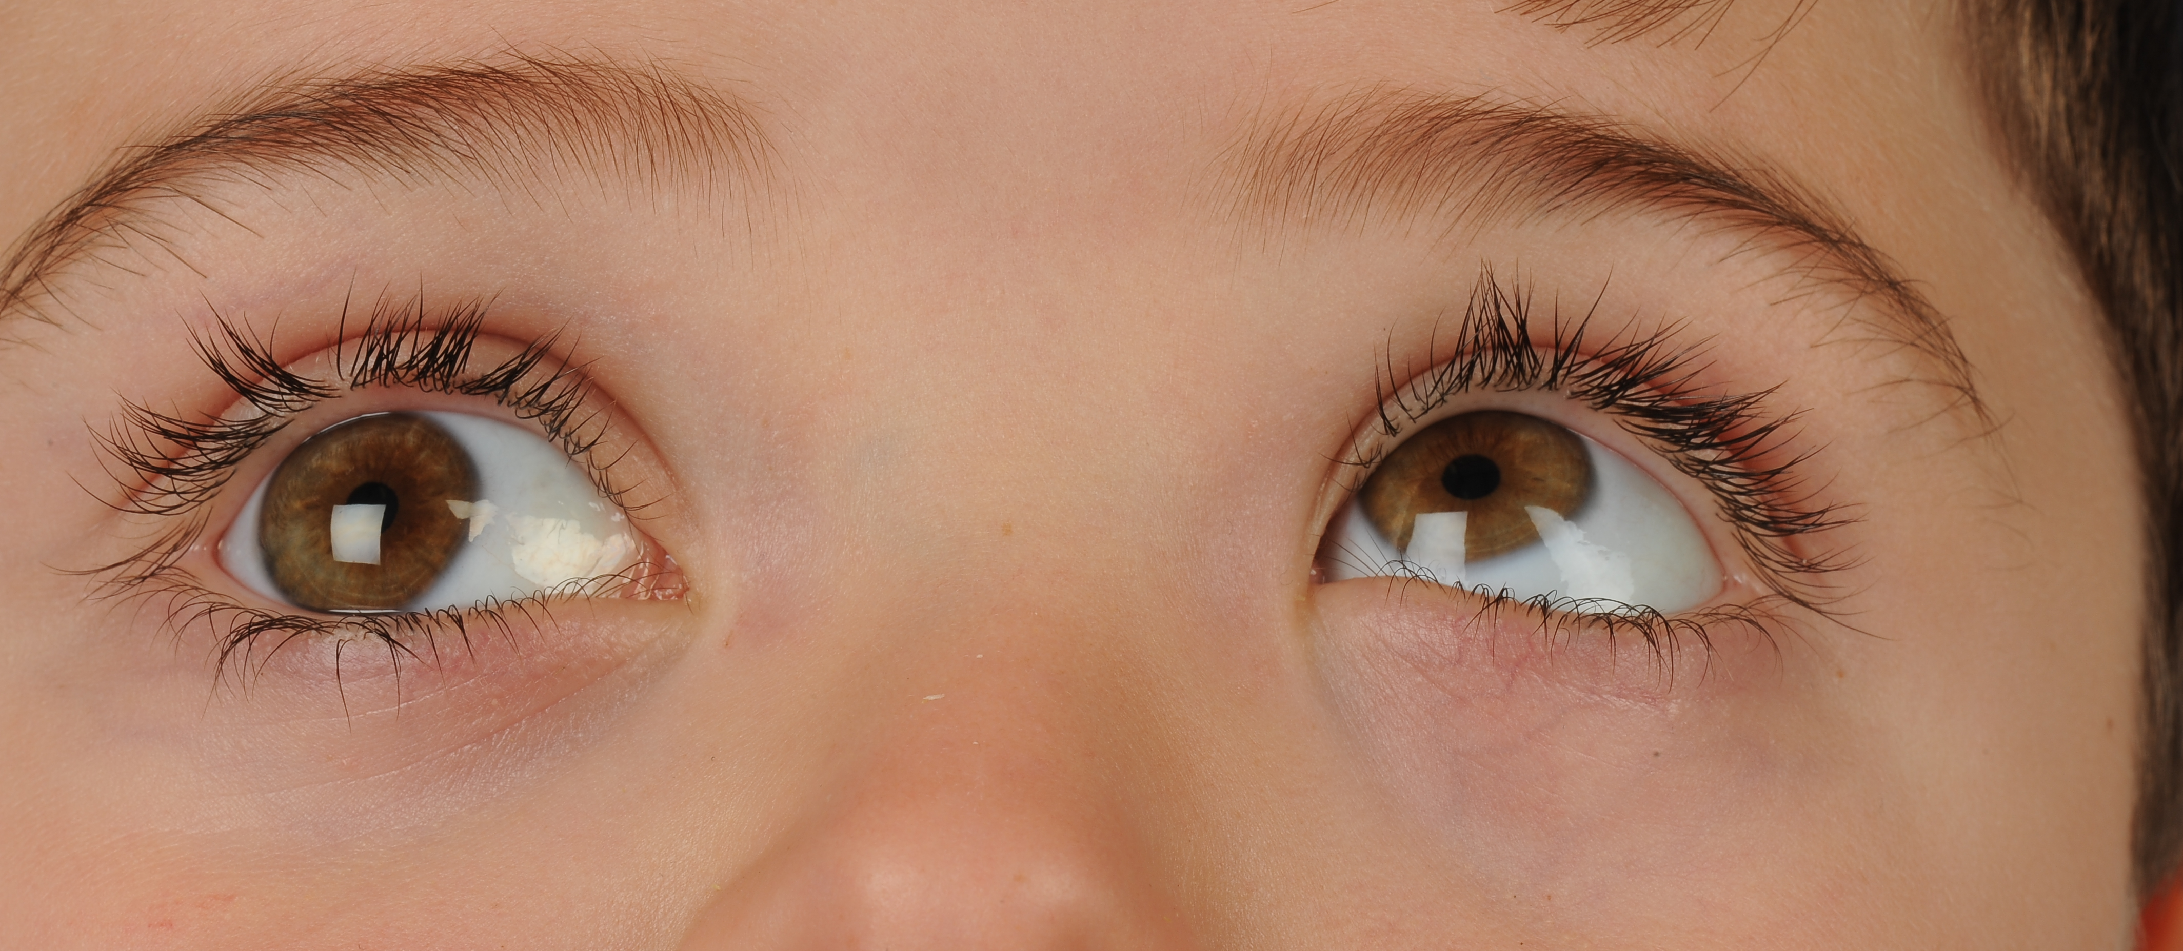
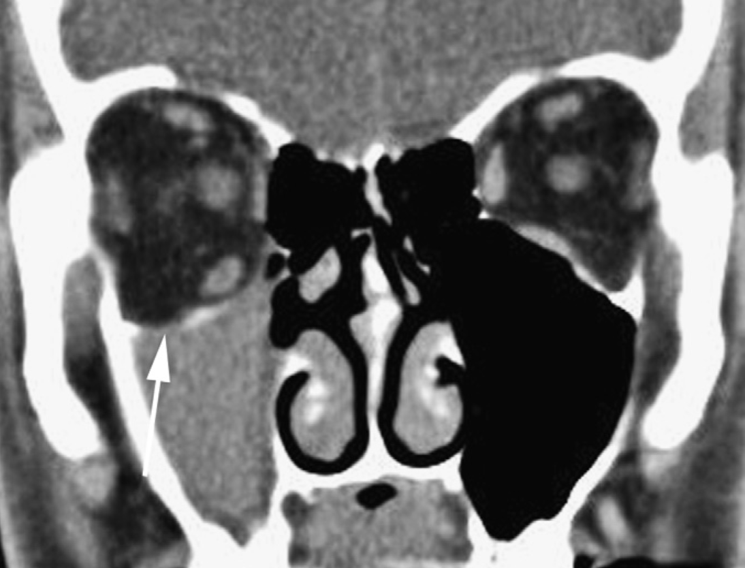
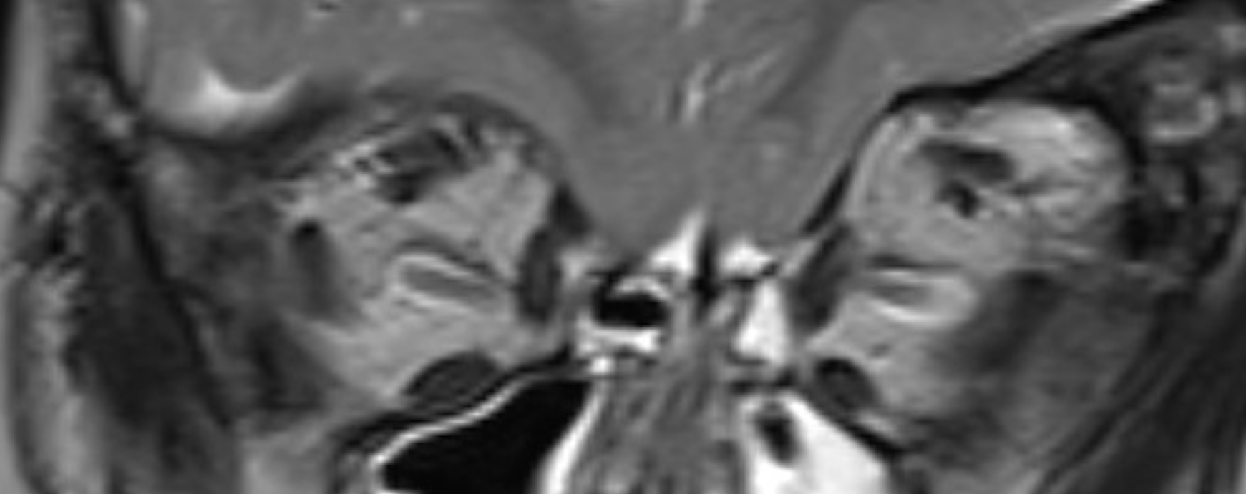
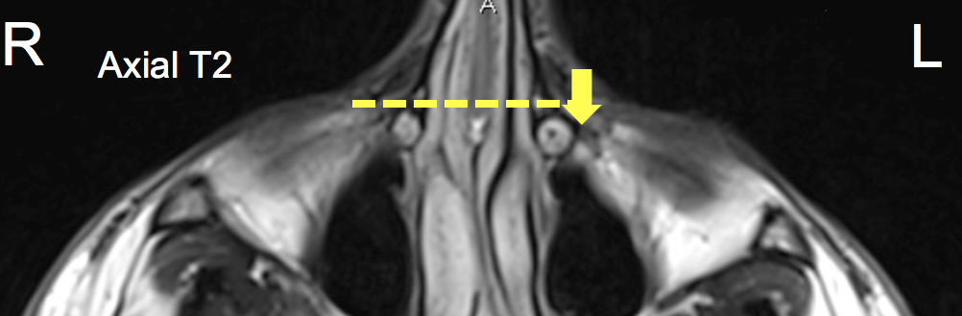
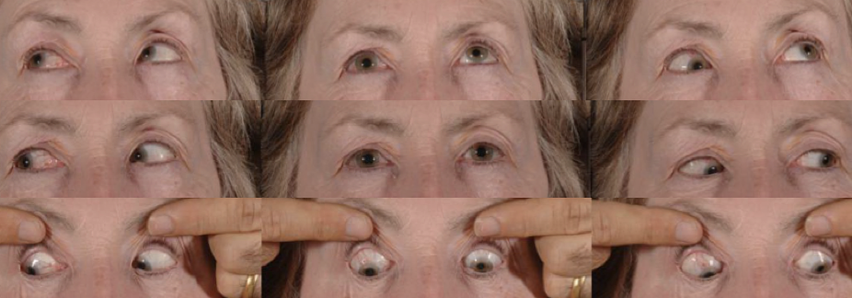
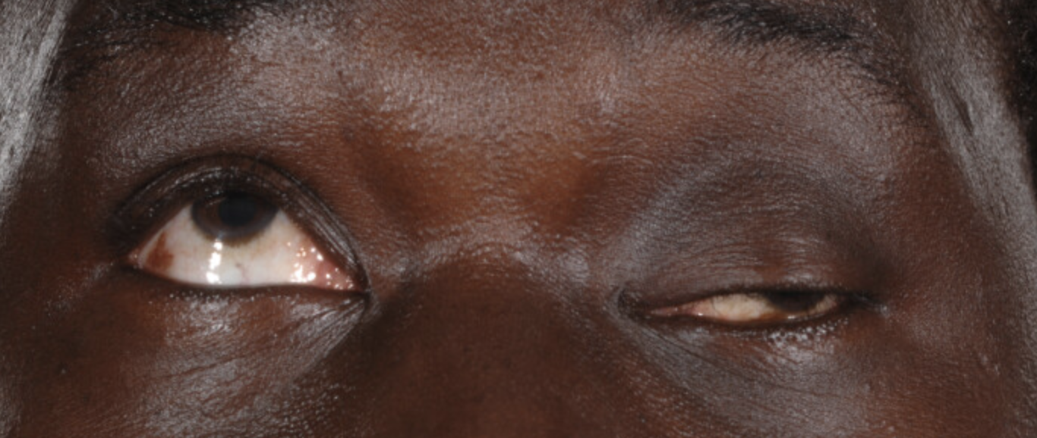
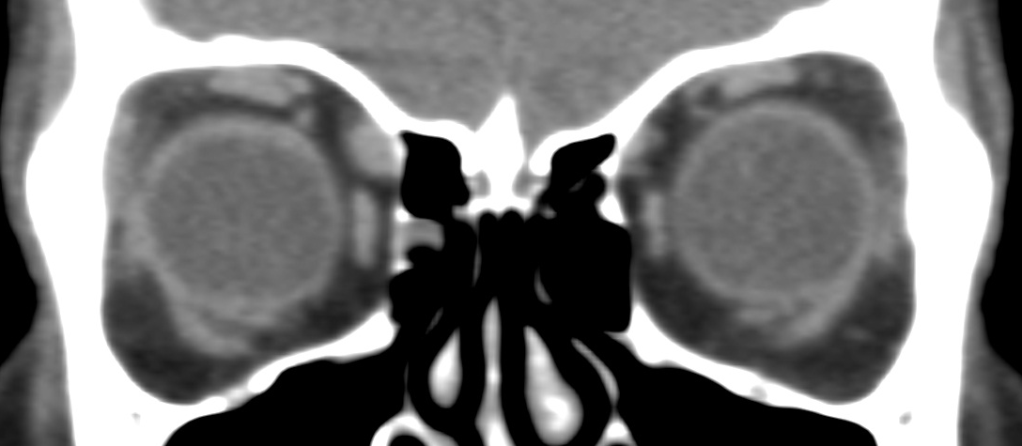
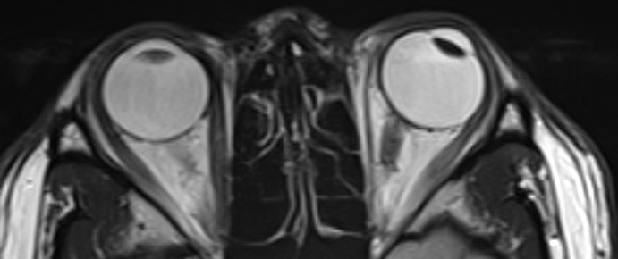
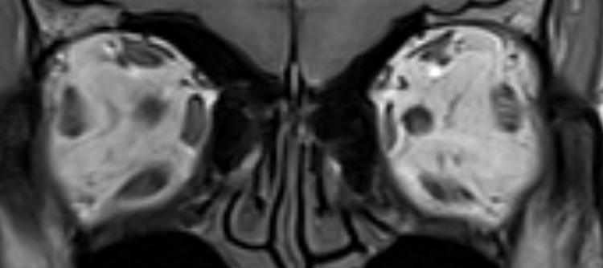
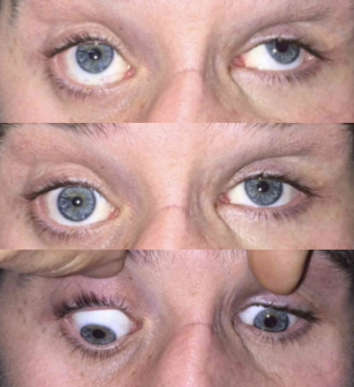
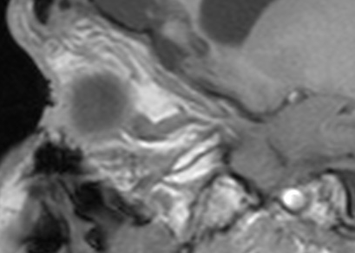
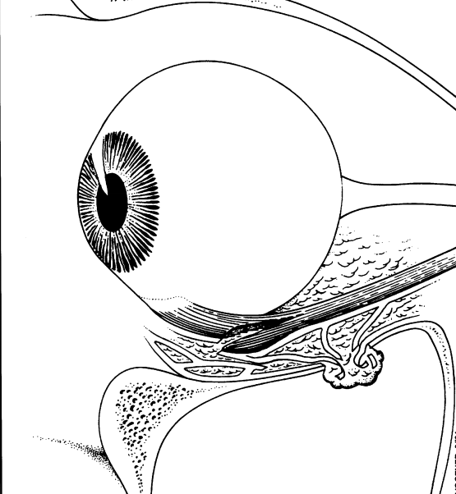
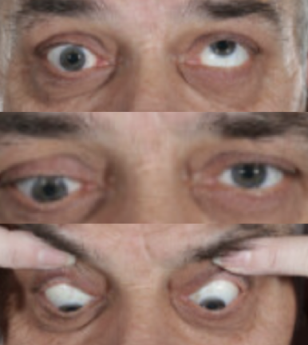
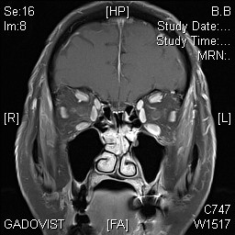
When Radiology of the Orbits
Does and Doesn’t Help in the Evaluation of Vertical Strabismus
Shivanand Sheth^{1,2}, Mali Okada¹, Lionel Kowal¹
¹The Royal Victorian Eye and Ear Hospital, Melbourne
²The Royal Children's’ Hospital, Melbourne
*
Introduction
Modern radiological imaging of the orbits has increased our understanding of the pathophysiology of different types of strabismus^{1,2}. We describe conditions when radiology of the orbits is useful in evaluation of vertical strabismus, and when it is unlikely to be of help.
Methods
The literature was reviewed, in addition to the authors’ clinical experience for radiological changes described in imaging of orbits of patients with different types of vertical strabismus, where radiology co-related with the clinical findings or helped in diagnosis and management. Some illustrative cases are shown below.
Results
Radiology of the orbits help in assessing volume, shape, and position of the extraocular muscles in patients with vertical strabismus. MRIs can detect extraocular muscle and pulley displacements in alphabet pattern strabismus¹. MRI can confirm a Superior Oblique (SO) palsy by demonstrating isotropic or anisotropic atrophy of the SO muscle³ (Fig 1 and 2). MRIs can help diagnose conditions that can simulate SO palsy such as extorted orbits⁴ (Fig 2), retro-placed SO trochleas⁵ (Fig 3), postero-placed inferior oblique origin (Fig 3), and silent sinus syndrome⁶ (Fig 4). Radiology can also demonstrate SO muscle enlargement in post-inflammatory acquired Brown’s syndrome (Fig 5). MRIs can also demonstrate muscle atrophy in third nerve palsies which can help diagnose superior division, inferior division and total third nerve palsies (Fig 6). Flap tears of the inferior rectus⁷ have been described intra-operatively in patients with trauma and MRI can assist with diagnosis of longitudinal split of the inferior rectus following trauma (Fig 7) and due to orbital implants⁸. Radiology can demonstrate entrapment of the inferior rectus in orbital fractures post trauma⁹. MRIs can also help confirm increased bulk and volume of extraocular muscles in vertical strabismus due to Thyroid eye disease (Fig 8). Generalised extraocular muscle enlargement has been reported in patients with dissociated vertical dissociation¹⁰, but the clinical significance or diagnostic utility of this is yet unknown.
Superior Oblique Palsies and Simulating Conditions
Brown’s Syndrome | Third Nerve Palsy
Trauma | Thyroid Eye Disease
Fig 1: MRI showing normal SO volume (top image), symmetric reduction in left SO volume (isotropic atrophy – middle image) and asymmetric reduction in left SO volume (anisotropic atrophy - bottom image). (Image taken from reference 3 )
Fig 2: Patient with plagiocephaly with right head tilt, left hypertropia and left inferior oblique overaction was diagnosed with left superior oblique palsy. MRI shows anisotropic atrophic left SO tendon (yellow arrow), and significantly excyclo-rotated left orbit
Fig 3: (Top) MRI shows postero-placed left trochlea (red arrow) in a patient with apparent left SO palsy. (Bottom) MRI shows postero-placed origin of left inferior oblique (yellow arrow) in a patient who presented with right inferior oblique overaction and presumed right SO palsy
Fig 4: Patient with left hypertropia and apparent left inferior oblique overaction and normal right inferior oblique function (Black arrows) was diagnosed clinically with left SO palsy. CT Scan demonstrated a right silent sinus syndrome (white arrow) as the cause of the vertical strabismus.
(Images taken from reference 6)
Fig 5: Patient with right eye acquired Brown’s syndrome shows severe limitation of right eye elevation in adduction. CT Scan shows large right superior oblique muscle consistent with myositis. (Red arrow)
Fig 6: MRI of patient with left partial 3rd nerve palsy shows thin ‘shoe-string’ left medial rectus (yellow arrows) and reduced muscle volume of left superior rectus (red arrow) with relatively preserved left inferior rectus volume (green arrow).
Fig 7 Patient presented with left hypertropia and limited depression of his left eye (yellow arrows) following trauma. MRI demonstrates disruption of the right inferior rectus (red arrows) with a flap tear of the right inferior rectus.
(Schematic image of flap tear taken from reference 7)
Fig 8: Patient presented with right hypotropia with limited right elevation (Blue arrow). MRI of another patient with a similar presentation shows an enlarged bulky right inferior rectus (yellow arrow) consistent with Thyroid eye disease
Discussion and Conclusion
SO palsies have traditionally been diagnosed clinically by the three-step test. Upto 30% of cases can be missed by the three step test ¹¹. The three-step test test is also often inaccurate in cases of contracture of the vertical recti, paresis of more than one vertical muscle, dissociated vertical deviation, previous vertical muscle surgery, skew deviation and myasthenia gravis¹² . MRI orbits are useful for confirming diagnosis of SO palsy by showing isotropic or anisotropic atrophy of the SO muscle and ruling out simulating causes of SO palsy. MRI of the superior oblique and pattern of atrophy can help explain the variations in presentations in SO palsies as a result of differential innervation¹³ . MRI orbits also useful in evaluation of vertical strabismus in Brown’s syndrome, third nerve palsies, post trauma and thyroid eye disease. MRI may currently not add value in evaluation of vertical strabismus caused by dissociated vertical deviations.
References
Demer JL. The Apt Lecture. Connective tissues reflect different mechanisms of strabismus over the life span. J AAPOS Off Publ Am Assoc Pediatr Ophthalmol Strabismus. 2014 Aug;18(4):309–15.
Demer JL, Clark RA, Kono R, Wright W, Velez F, Rosenbaum AL. A 12-year, prospective study of extraocular muscle imaging in complex strabismus. J AAPOS 2002; 6(6): 337–347
Shin SY, Demer JL. Superior oblique extraocular muscle shape in superior oblique palsy. Am J Ophthalmol. 2015 Jun;159(6):1169–1179.e2.
Tan KP, Sargent MA, Poskitt KJ, Lyons CJ. Ocular overelevation in adduction in craniosynostosis: is it the result of excyclorotation of the extraocular muscles? J AAPOS 2005; 9(6): 550–557.
Bagolini B, Campos EC, Chiesi C. Plagiocephaly causing superior oblique deficiency and ocular torticollis. A new clinical entity. Vol. 100, Archives of ophthalmology. 1982. p. 1093–6
Zhang C, Phamonvaechavan P, Christoff A, Guyton DL. Silent sinus syndrome causing cyclovertical diplopia masquerading as superior oblique paresis in the fellow eye. J AAPOS 2010 Oct;14(5):450–2.
Ludwig IH, Brown MS. Flap tear of rectus muscles: an underlying cause of strabismus after orbital trauma. Ophthal Plast Reconstr Surg. 2002;18(6):443–9; discussion 450.
Laursen J, Demer JL. Traumatic longitudinal splitting of the inferior rectus muscle. J AAPOS. 2011;15(2):190–2.
Harris GJ, Garcia GH, Logani SC, Murphy ML, Sheth BP, Seth AK. Orbital blow-out fractures: correlation of preoperative computed tomography and postoperative ocular motility. Trans Am Ophthalmol Soc 1998;96:329-47-53.
Rajab GZ, Suh SY, Demer JL. Magnetic resonance imaging in dissociated strabismus complex demonstrates generalized hypertrophy of rectus extraocular muscles. J Am Assoc Pediatr Ophthalmol Strabismus 2017;21(3):205–9.
Demer JL. Sensitivity of the three-step test in diagnosis of superior oblique palsy. J AAPOS. 2014;18(6):567–71.
Kushner BJ. Errors in the three-step test in the diagnosis of vertical strabismus. Ophthalmology. 1989 Jan;96(1):127–32.
Suh SY, Clark RA, Le A, Demer JL. Extraocular muscle compartments in superior oblique palsy. Investig Ophthalmol Vis Sci. 2016;57(13):5535–40.

